Slide 1
CS 4530: Fundamentals of Software Engineering Module 3, Lesson 5 JavaScript in the Browser
Rob Simmons
Khoury College of Computer Sciences

Slide 2






So, software engineering must encompass:
PEOPLE
PROCESSES
PROGRAMS
PLANNING
We’re gonna be stuck over here for a bit.
ORGANIZING
implementing

Slide 3
So, software engineering must encompass:
PEOPLE
PROCESSES
PROGRAMS
PLANNING
We’re gonna be stuck over here for a bit.
But also, there’s something to be said for the firehose
ORGANIZING
implementing

Slide 4
Learning Objectives for this Lesson
By the end of this lesson, you should be able to:
Describe the relationship between JavaScript, TypeScript, HTML, and the Document Object Model (DOM)
Explain the historical and present value of “frontend tooling”
Notes:
Tonight's subject is REACT, our web framework. We have two lessons,
roughly: basic REACT, and advanced REACT.
<Read slide>

Slide 5

HTML: The Markup Language of the Web
Language for describing structure of a document
Denotes hierarchy of elements
Browser turns this into a “live” version — the Document Object Model (DOM)
(Inspector demo)

Slide 6
Frontend tooling
Approximate timeline:
2006: jQuery makes direct DOM manipulation fun
2010: NodeJS
2011: React (Facebook internal)
2012: TypeScript
2013: React&JSX (public)
People got very used to having to compile their hundreds of not-browser-JavaScript files to one Browser JavaScript to do anything (makes dev slow!)
NONE of these run
in the browser directly

Slide 7
Frontend tooling
Many build steps are technically unnecessary… but it’s been a long, long road
2015: ES Modules introduced (import)
2019: ES Modules in NodeJS, all major browsers support
2020: Vite explores using ES Modules to avoid regenerating the one-big-JavaScript-file for every minor change while developing code
2022: All supported versions of NodeJS support ES Modules
2022: (Still-controversial, possibly doomed) proposal for “types as comments” in the JavaScript standard
January 7, 2025: NodeJS v23.6 allows direct running of TypeScript files with no extra configuration (just ignores the types)
May 6, 2025: NodeJS 24.x is the first long-term supported version of NodeJS that allows direct running of TypeScript files

Slide 8
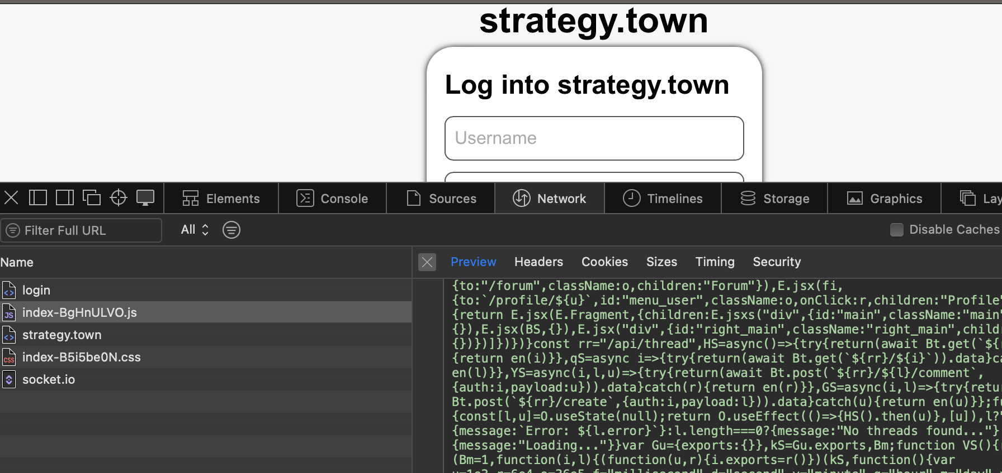
Frontend tooling
Frontend tooling is not going anywhere:
It reduces the size of the JS that ever needs to be downloaded
Frontend tooling enables powerful browser caching strategies

